Slide 1
Hello we are group 1
Welcome to our project

Slide 2

Group’s members
Le Thai Anh – Front end
Nguyen Quang Du – Back end
Phung Quang Thanh – Back end ( Group’s Leader )

Slide 3
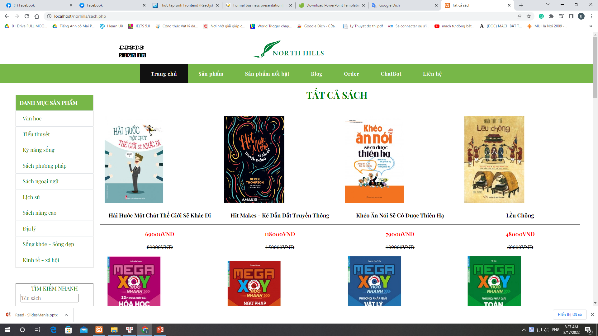
General about the project
1
2
A web for selling books
Customer can order and pay for their book with an account
3
With admin account to manage web

Slide 4

Programing technologies using in our project
Front-end: HTML, CSS, JS
Back-end: PHP

Slide 5
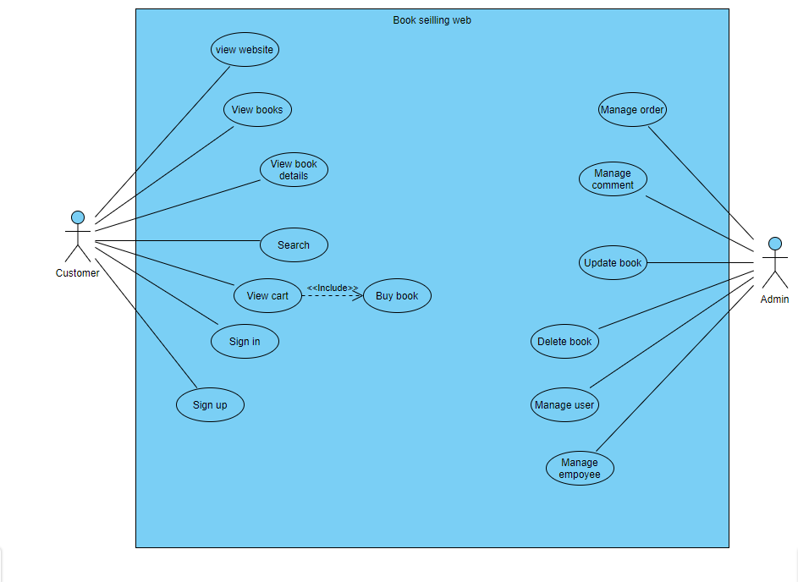
Use case diagram

Slide 6
Achievement and Drawbacks
Achievement
Drawbacks
We have been built a website for everybody can use easily
Very simple to manage with admin page
- Still can’t use laravel framework for coding and make it more efficient

Slide 7
DEMO

Slide 8
Thanks for watching
This is where you section ends. Duplicate this set of slides as many times you need to go over all your sections.

